Slide 1
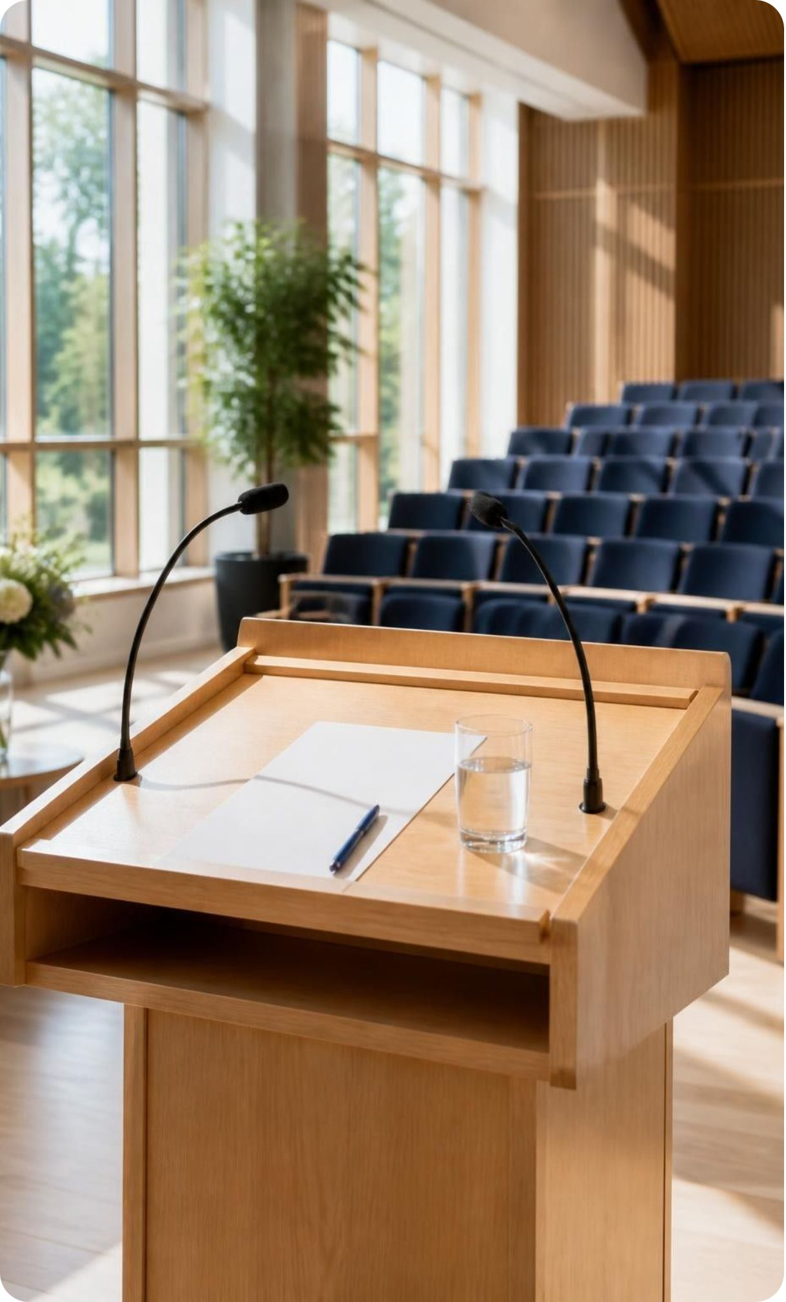
BMC ACADEMIA
Good Afternoon
BMC & Honored Organizers
Thank you to the organizers and leadership for this platform.
Next-Gen Student Academic Platform
Notes:
Good afternoon to BMC and our honored organizers. Thank you to the leadership and organizers for giving us this platform. Today we introduce BMC Academia, our vision for a Next-Gen Student Academic Platform.

Slide 2

THE FIRST QUESTION
What's the single most important asset to every person?
TIME
An irreplaceable, non-renewable resource.
It governs academic performance and growth.
Notes:
Ask the question and pause before revealing the answer. Time is the resource we cannot replenish. How students use it shapes both their academic performance and their opportunity to grow.

Slide 3

THE SECOND QUESTION
What has grown exponentially over the past decades?
KNOWLEDGE
Syllabi, course depth, and learning resources are expanding faster than ever across all faculties.
More to understand. More to connect. More to retain.
Notes:
Pause on knowledge. Across faculties, students face deeper courses and a growing volume of learning resources. The opportunity to learn is expanding, but the time available in a semester remains limited.

Slide 4
THE LAST QUESTION
What is the #1 limitation for every learner?
TIME
Dense materials. Tight semester timelines.
Students are overwhelmed filtering study materials before they can focus on understanding them.
Notes:
Time appears again, this time as the learner's limitation. Students must work through dense materials within tight semester timelines. Filtering what matters consumes time that could otherwise go into understanding and revision.

Slide 5


THE PLATFORM
Introducing BMC Academia
Exponential Knowledge
Finite Time
A growing volume to learn.
A limited window to learn it.
Need for High-Efficiency Learning
A unified platform for BMC students across all faculties to absorb maximum knowledge in minimal time.
Notes:
This equation captures the need behind BMC Academia: exponential knowledge plus finite time creates a need for high-efficiency learning. Our aim is one unified academic platform for BMC students across all faculties.

Slide 6



LEARNING TOOLKIT
Core Features
Smart Flashcards
Concise Notes
Active recall cards for quick concept revision.
High-yield, short summaries of complex lecture topics.
PYQs & Solutions
Custom Resource Ingestion
Past year questions with detailed solutions for exam confidence.
Upload personal PDFs, video links, and web links to auto-generate notes, flashcards, and practice questions.
Notes:
Walk through the four features. Concise notes support understanding, flashcards support active recall, and past year questions with solutions support exam preparation. Custom resource ingestion extends the toolkit to the materials students already use.

Slide 7



FUTURE VISION · PROPOSED CAPABILITIES
Future Vision: Hardware & Gamification
Smart Recording
Auto Transcripts
Focus Leaderboard
Small IoT devices in classrooms record live lectures for absent students.
AI transcriptions and summaries from classroom recordings.
An engagement dashboard showing top students by focused study hours.
Keep lectures accessible.
Make recordings revisable.
Recognize focused effort.
Notes:
These are future-facing capabilities, not a claim of completed deployment. Recording could help absent students access lectures, transcription could make recordings easier to revise, and a focus leaderboard could recognize sustained study effort.

Slide 8




TEAM · PLACEHOLDERS TO COMPLETE
The Minds Behind BMC Academia
[Name 1]
[Name 2]
[Name 3]
[Name 4]
[Role]
[Contribution to BMC Academia]
[Role]
[Contribution to BMC Academia]
[Role]
[Contribution to BMC Academia]
[Role]
[Contribution to BMC Academia]
Profile slots are illustrative. Replace with confirmed names, roles, contributions, and individual photographs.
Notes:
No team details were supplied. These are clearly marked profile placeholders, not a statement of team size or responsibilities. Replace the slots with confirmed information before presenting.

Slide 9
BMC ACADEMIA · OPEN DISCUSSION
Thank You
& Q&A
The floor is open for questions and feedback from judges, faculty, and the audience.
Which learning challenge should BMC Academia address first?
Notes:
Thank the organizers and audience, then invite questions. Welcome feedback from judges, faculty, and students on the proposed features and the learning challenges that deserve priority.

